Slide 1
Christian Theory: Augustine and Aquinas
Politics 2A
Karen Wright

Slide 2
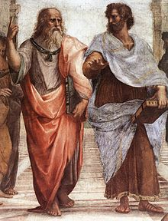

Slide 3
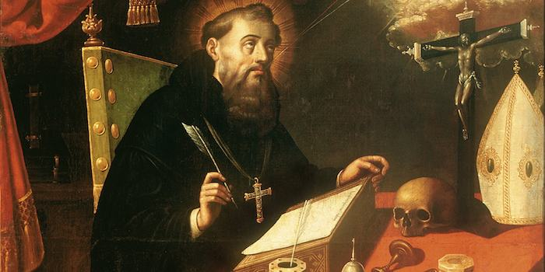
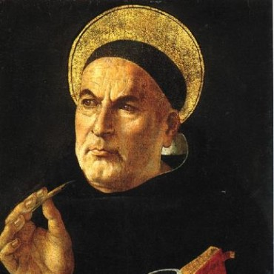
Augustine
Aquinas

Slide 4
Christianity and politics: Augustine
410 AD – Rome sacked by Goths. Christianity widely blamed.
413-26 AD – City of God. Introspection and pessimism. Belief rather than knowledge. Faith rather than reason. (Neo-platonism)
- Earthly city (Loyalty to self, honour, glory) punished for sin and pride. Willfulness and sins of the flesh. Mans nature, will and reason inherently corrupt.
- Heavenly city (ideal form) ( Loyalty to God) Redemption through grace. Predestination.
‘Participate in this world; love the next. Pilgrims in the City of Man.’

Slide 5
Politics
Not possible to achieve a rational and just state: Greek traditions wrong, arrogant and naive.
A necessary evil as a consequence of the fall. Aim – relative peace, not human fulfilment. Form of rule indifferent, but should obey authority. Original sin justifies all treatment – no grounds for objection.
No true justice on earth, only the shadow.
But….Just War Thy

Slide 6
Monasticism
Continuation of learning, writing, illustrated gospels
Ireland (St. Patrick 4th/5th century)
Whithorn (St Ninian, 5th century)
Iona (St. Columba 6th century)
Glasgow (St Mungo /Kentigern) 7th century

Slide 7
Christianity and Politics: Aquinas
Summa Theologica 1266-72
Rediscovery of classic writings, especially Aristotle.
Compatibility of faith and reason. ‘Return of Reason’ Reason not impaired by the fall – rather will was impaired.
Man is a social and political animal. Man is rational, moral and social. Justice is knowing place and doing one’s duty.
Christianity and citizenship. Church and state compatible. Doing good through service. Virtuous habits are important.

Slide 8
Politics
State is natural, valued as expression of God’s will for man
Fulfilment is possible both by being a good Christian and a good citizen.
Moral duty to act in accord with reason.
Possible to know and do what is good and therefore to create a good society ( on earth)
Hierarchical nature of the universe reflected in monarchy BUT constrained by Laws (of Nature).
Eternal law
Divine law
Natural law
Human law

